Slide 1
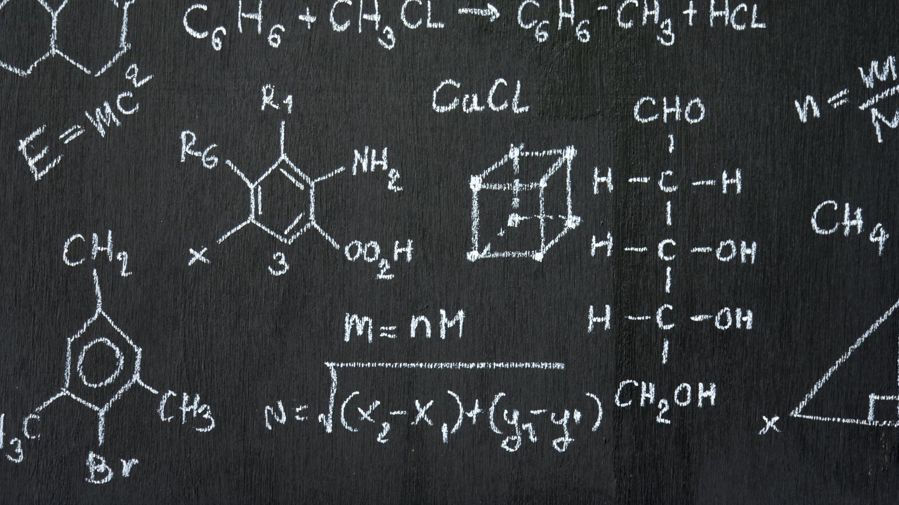
Control Structures I (Selection)

Slide 2
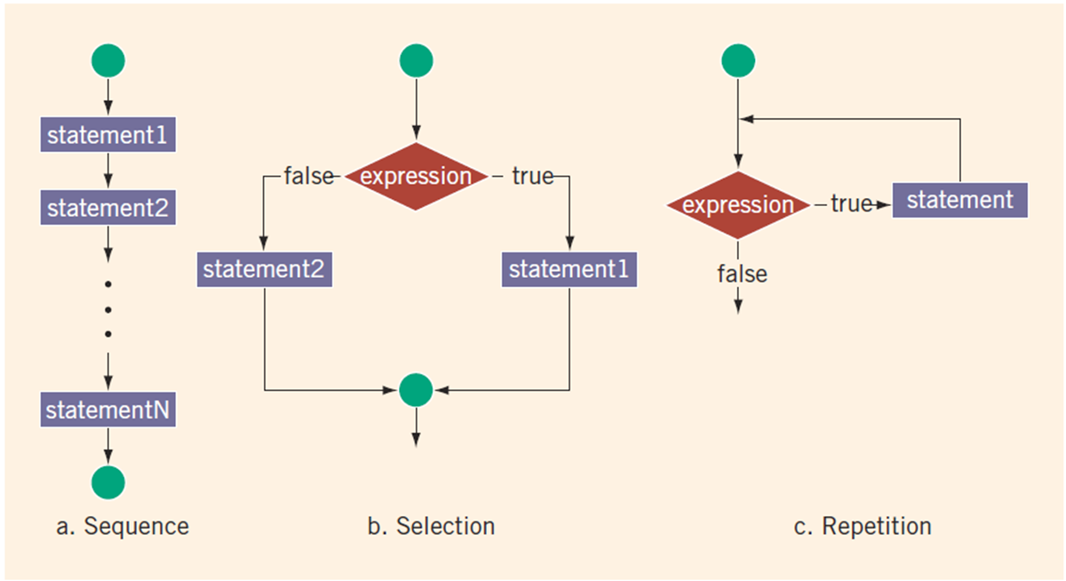
Control Structures
A computer can proceed:
In sequence
Selectively (branch): making a choice
Repetitively: looping
By calling a function

Slide 3
Relational Operators in C++
An expression that evaluates to true or false is called a logical expression
Operator | Description
== | equal to
!= | not equal to
< | less than
<= | less than or equal to
> | greater than
>= | greater than or equal to
https://replit.com/@btaylan/CISC3142Codes#Lecture-3/1.cpp

Slide 4
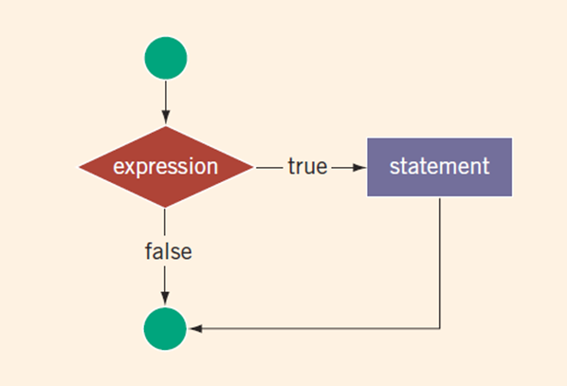
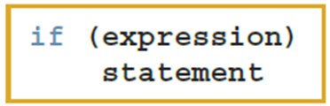
One-Way Selection
One-way selection syntax
The statement is:
Executed if the value of the expression is true
Bypassed if the value is false; program goes to the next statement
The expression is also called a decision maker
The statement following the expression is also called the action statement
https://replit.com/@btaylan/CISC3142Codes#Lecture-3/2.cpp
https://replit.com/@btaylan/CISC3142Codes#Lecture-3/3.cpp
https://replit.com/@btaylan/CISC3142Codes#Lecture-3/4.cpp

Slide 5
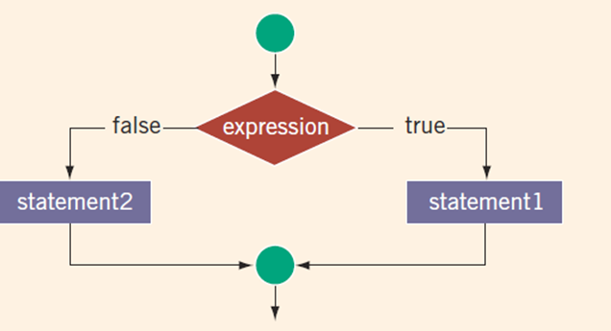
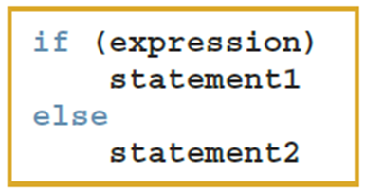
Two-Way Selection
Two-way selection syntax
If expression is true, statement1 is executed; otherwise, statement2 is executed
https://replit.com/@btaylan/CISC3142Codes#Lecture-3/5.cpp

Slide 6
int Data Type and Logical (Boolean) Expressions
Earlier versions of C++ did not provide built-in data types that had Boolean values
You can use the int data type to manipulate logical (Boolean) expressions
int legalAge;
int age;
legalAge = (age>=21); //Assigns 1 or 0 depending on age

Slide 7
bool Data Type and Logical (Boolean) Expressions
Newer versions of C++ provides built-in data types that had Boolean values
You can use the int data type to manipulate logical (Boolean) expressions
bool legalAge;
int age;
legalAge = (age>=21); //Assigns 1 or 0 depending on age
https://replit.com/@btaylan/CISC3142Codes#Lecture-3/6.cpp

Slide 8
Logical (Boolean) Operators and Logical Expressions
Operator | Description
! | not
&& | and
|| | or
Relational and logical operators are evaluated from left to right
The associativity is left to right
Parentheses can override precedence
https://replit.com/@btaylan/CISC3142Codes#Lecture-3/7.cpp

Slide 9
Order of Precedence
Operators | Precedence
!, +, - (unary operators) | first
*, /, % | second
+, - | third
<, <=, >=, > | fourth
==, != | fifth
&& | sixth
|| | seventh
= (assignment operator) | last
https://replit.com/@btaylan/CISC3142Codes#Lecture-3/8.cpp

Slide 10
Relational Operators and the string Type
Relational operators can be applied to variables of type string
Strings are compared character by character, starting with the first character
Comparison continues until either a mismatch is found, or all characters are found equal
https://replit.com/@btaylan/CISC3142Codes#Lecture-3/9.cpp

Slide 11
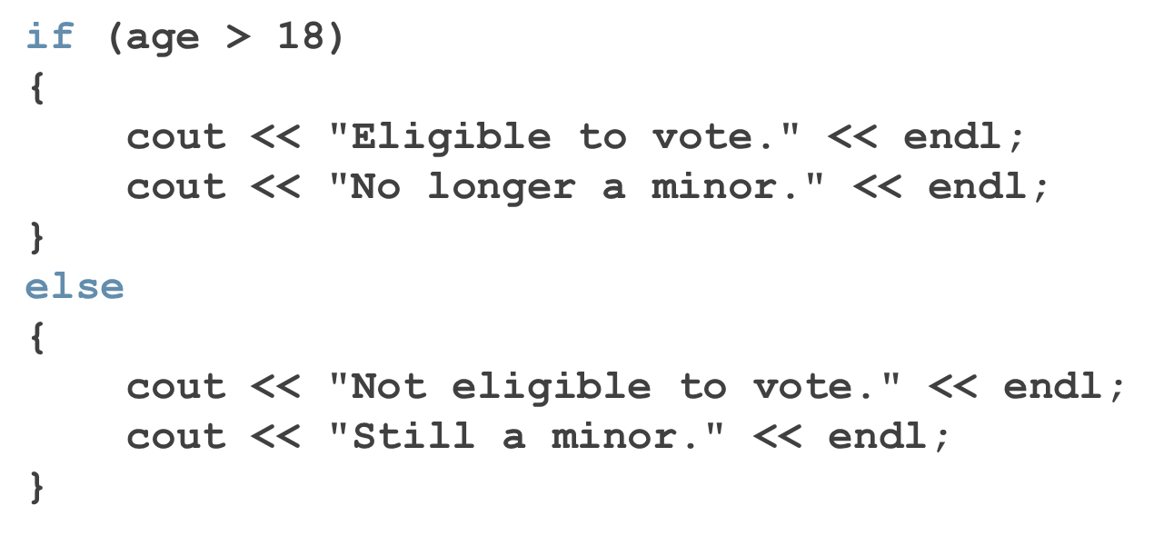
Compound (Block of) Statements

Slide 12
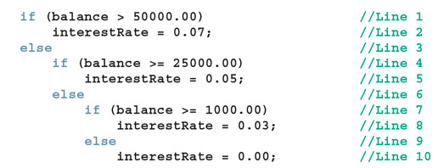
Nested if
Pair if-else statements:

Slide 13
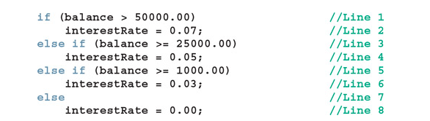
Else-If
To avoid excessive indentation, the previous code can be rewritten as follows:

Slide 14
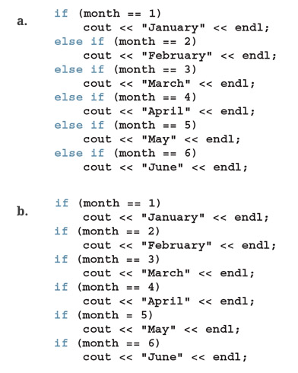
Comparing if…else Statements with a Series of if Statements
Both a and b accomplish the same task

Slide 15
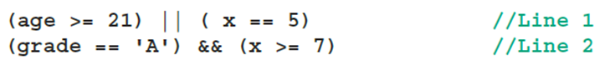
Short-Circuit Evaluation
Short-circuit evaluation: the logical expression is evaluated from left to right.
As soon as the final value of the entire logical expression is known, the evaluation stops.
Consider the following expressions:
If age=>21, then no need to check (x==5)
If grade!=A, then no need to check (x>=7)

Slide 16
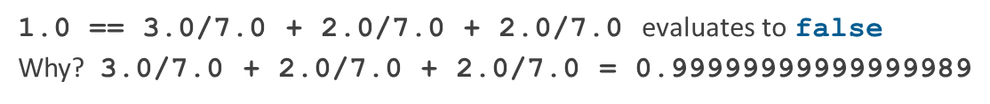
Comparing Floating-Point Numbers for Equality: A Precaution
Comparison of floating-point numbers for equality may not behave as you would expect
Example:

Slide 17
Associativity of Relational Operators: A Precaution
Order of changes the result of logical operations.
See two of the examples below:
https://replit.com/@btaylan/CISC3142Codes#Lecture-3/11.cpp
https://replit.com/@btaylan/CISC3142Codes#Lecture-3/10.cpp

Slide 18
Avoiding Bugs by Avoiding Partially Understood Concepts and Techniques
Assume score is a double value identify issues:
Example-1:
if score >= 90
cout << ‘A’ << endl;
Example-2:
if (score >= 90);
cout << ‘A’ << endl;

Slide 19
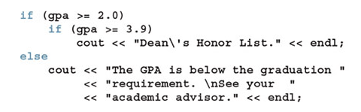
Avoiding Bugs by Avoiding Partially Understood Concepts and Techniques
Example-3:

Slide 20
Input Failure and the if Statement
If an input stream enters a fail state:
All subsequent input statements associated with that stream are ignored
Program continues to execute
The code may produce erroneous results
Use if statements to check status of input stream
If the input stream enters the fail state, include instructions that stop program execution
https://replit.com/@btaylan/CISC3142Codes#Lecture-3/12.cpp
https://replit.com/@btaylan/CISC3142Codes#Lecture-3/13.cpp

Slide 21
Confusion Between the Equality (==) and Assignment (=) Operators
What is the output?
int x= 5;
if(x=3)
cout << "x is three" << endl;
else
cout << "x is five" << endl;
https://replit.com/@btaylan/CISC3142Codes#Lecture-3/14.cpp

Slide 22
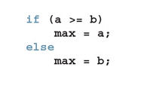
Conditional Operator (?:)
Conditional (Ternary) operator: takes three arguments
Example:
Equivalent to:

Slide 23
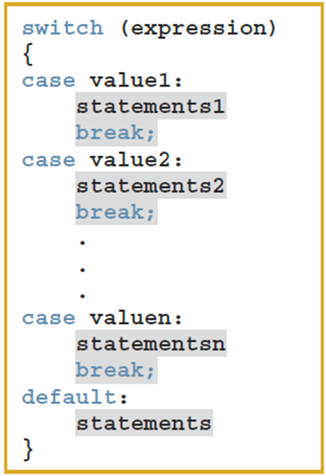
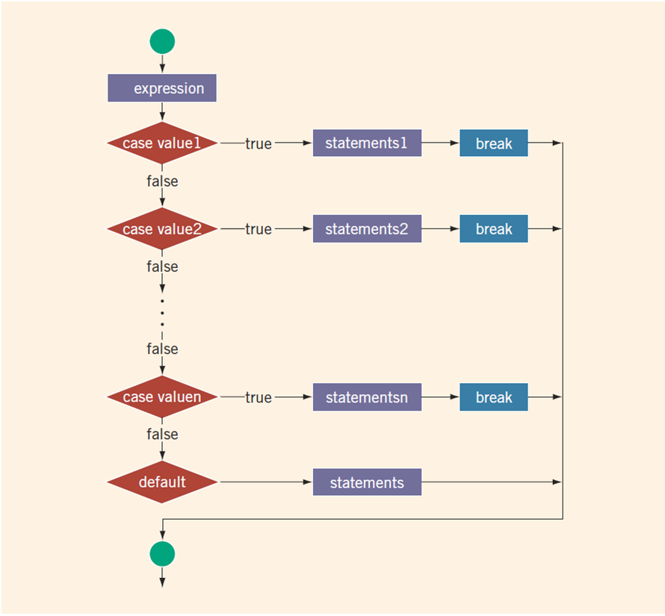
switch Structures
switch structure is an alternate to if-else

Slide 24
switch Structures
If Example:
https://replit.com/@btaylan/CISC3142Codes#Lecture-3/15.cpp
switch Example:
https://replit.com/@btaylan/CISC3142Codes#Lecture-3/16.cpp
switch Example With Bugs:
https://replit.com/@btaylan/CISC3142Codes#Lecture-3/17.cpp

Slide 25
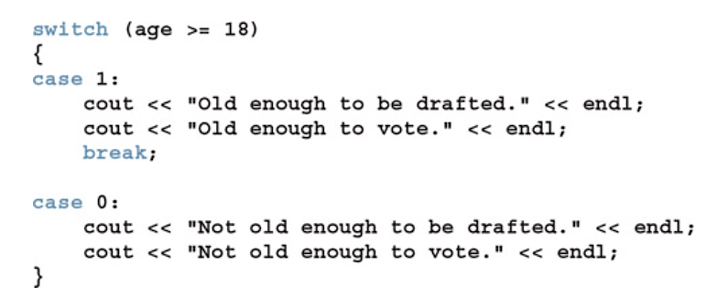
switch with Logical Expression

Slide 26
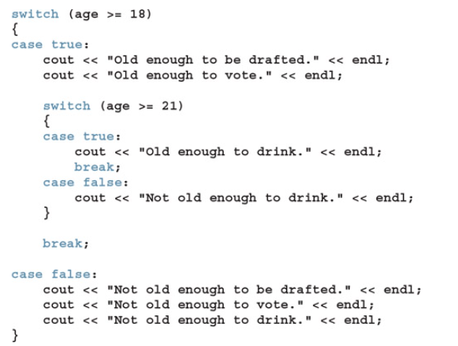
Nested switch

Slide 27
Terminating a Program with the assert Function
Certain types of errors are very difficult to catch
Example: division by zero
The assert function is useful in stopping program execution when certain elusive errors occur

Slide 28

The assert Function
expression is any logical expression
If expression evaluates to true, the next statement executes
If expression evaluates to false, the program terminates and indicates where in the program the error occurred
To use assert, include cassert header file

Slide 29
The assert Function
assert is useful for enforcing programming constraints during program development
After developing and testing a program, remove or disable assert statements
The preprocessor directive #define NDEBUG must be placed before the directive #include <cassert> to disable the assert statement
https://replit.com/@btaylan/CISC3142Codes#Lecture-3/18.cpp

